Slide 1

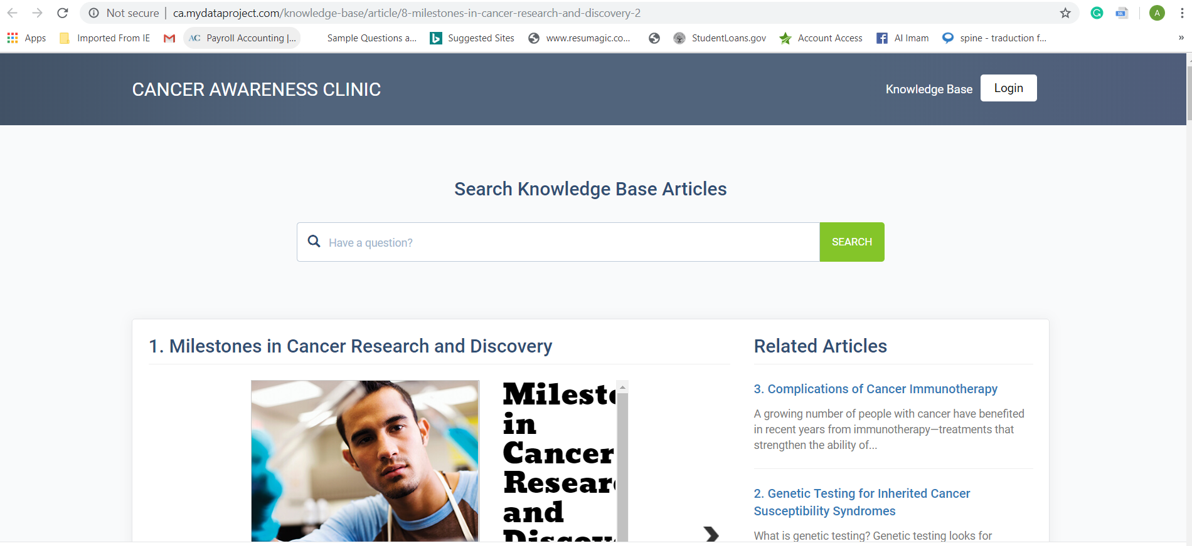
Patient Portal and Knowledge Base

Slide 2


If you were born after 1960…
….There’s a
50%
chance you will get cancer
Do you know that almost half of cancers are diagnosed only when the disease is at an advanced stage, meaning treatment is both more expensive and less likely to succeed?

Slide 3

Cancer Awareness: Basics of how cancer works and the broad cancer types in a simple and understandable way.
Data visualization with Clinics Map, Charts for Diagnosis and Cancer types
AI or Machine Learning to reduce the risk of developing Cancer

Slide 4
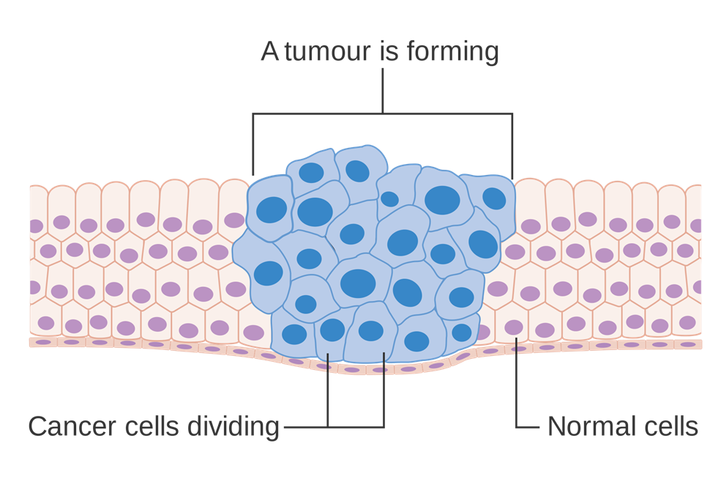
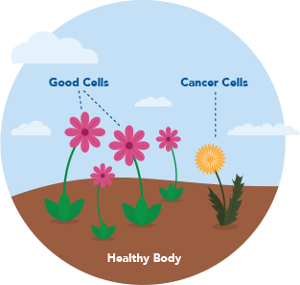
What even is cancer?!
Oncology
Cancer: when abnormal cells divide in an uncontrolled way
There are over 100 types of cancer that affect humans
Cancers cells are like weeds in your garden. Sometimes, the soil can allow weeds to grow and spread, and soon, the entire garden suffers as your plants compete for space and nutrients

Slide 5

We class cancer by cell type
We can group cancers according to the type of cell they start in
There are five main types:
Carcinoma
Sarcoma
Leukemia
Lymphoma and myeloma
Brain and spinal cord cancers
We can also classify cancers accordingly to where they start in the body e.g. brain cancer

Slide 6

We classify cancer into disease stage

Slide 7

Top 10 Cancers by Rates of New Cancer Cases

Slide 8

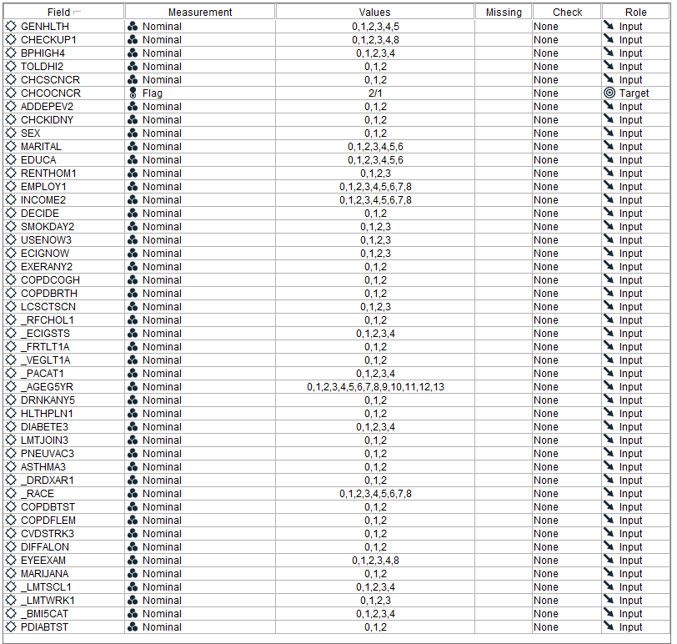
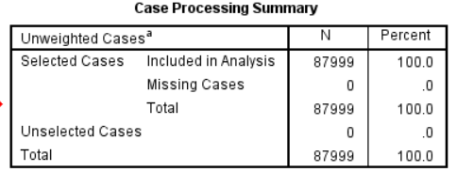
Data & Descriptive statistics
The Behavioral Risk Factor Surveillance System (BRFSS) is the nation’s premier system of health-related telephone surveys that collect state data about U.S. residents regarding their health-related risk behaviors, chronic health conditions, and use of preventive services.
The aggregate BRFSS combined landline and cell phone dataset is built from the landline and cell phone data submitted for 2017 and includes data for 50 states, the District of Columbia, Guam, and Puerto Rico.

Slide 9
Model (Multinomial Logistic Regression)
Logistic regression is a model of probability so we can use it to predict the probability of something.
The model is used to study quantitative relations between the happening of cancer and many risk factors.
Input: Training & Testing Data
Compute regression coefficients of training data
y=1/(1+e^(-x))
Find the relationship between the training & testing data
Output the Results and Test
Develop AI & Use the model in production

Slide 10
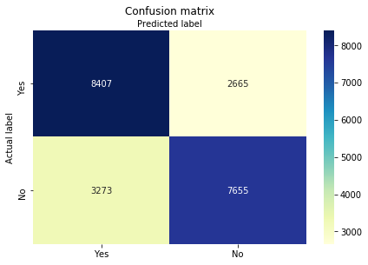
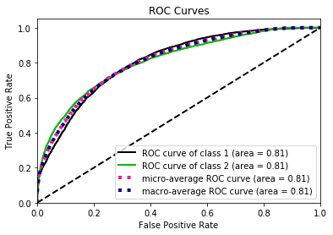
Model Evaluation Metrics
Training Data Score: 0.7330111062288822 Testing Data Score: 0.7300909090909091
Rock AUC Score : 0.73011062

Slide 11
Predictive Description
index | Predicted_value | Actual_value | yes_1 | no_2
1 | No | No | 0.469 | 0.531
2 | No | Yes | 0.384 | 0.616
3 | Yes | Yes | 0.509 | 0.491
4 | Yes | Yes | 0.731 | 0.269
5 | Yes | Yes | 0.719 | 0.281
6 | No | No | 0.123 | 0.877
7 | No | No | 0.248 | 0.752
8 | No | No | 0.065 | 0.935
9 | Yes | Yes | 0.694 | 0.306
10 | Yes | Yes | 0.654 | 0.346
11 | No | No | 0.184 | 0.816
12 | No | No | 0.318 | 0.682
13 | No | Yes | 0.478 | 0.522
14 | Yes | Yes | 0.875 | 0.125
15 | No | No | 0.252 | 0.748

Slide 12
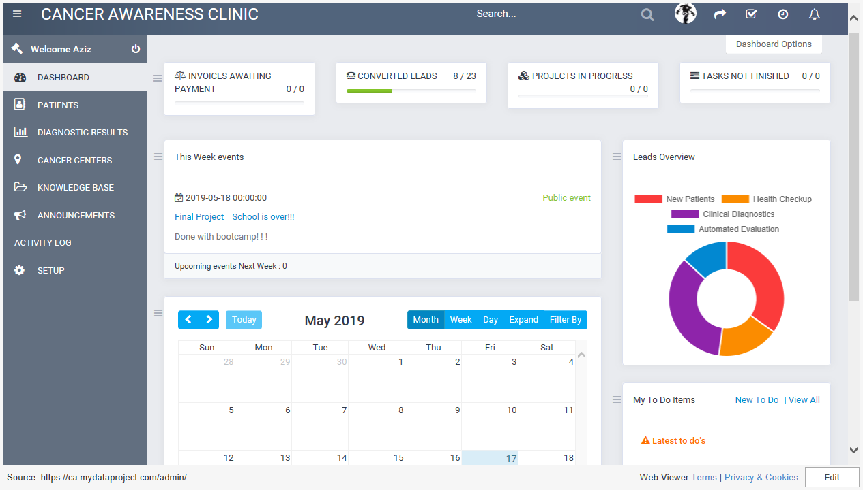

Slide 13






Host Server
Host Server
1
CSV Data File
3
2
4
Data is stored
Website
MySQL
AI Engine
User Inputs
Logistic Regression
Tableau
Python Script
Zepl.com
6
Data for dashboard
5
Predicted Output

Slide 14
Resources
www.theguardian.com/science/2015/feb/04/half-people-britain-cancer-research
Machine learning for Healthcare Analytics, Eduonix Learning Solution
Havas Lynx Group-- Dr Ashley Davies
https://www.youtube.com/watch?v=ZGJ169HpZqc&feature=youtu.be
www.webmd.com/cancer/understanding-cancer-basics
https://gis.cdc.gov/Cancer/USCS/DataViz.html

Slide 15
Team members
Aziz Isamedinov
Alimam Diaby
Carlos Cuevas
Mike Patterson
Prakriti Rana

